Slide 1
Getting started
Lesson 5: Bitmap graphics

Slide 2
Objectives
In this lesson, you will learn:
the features of bitmap graphics
bitmap graphic file types
how to edit bitmap graphics using image editing software.

Slide 3
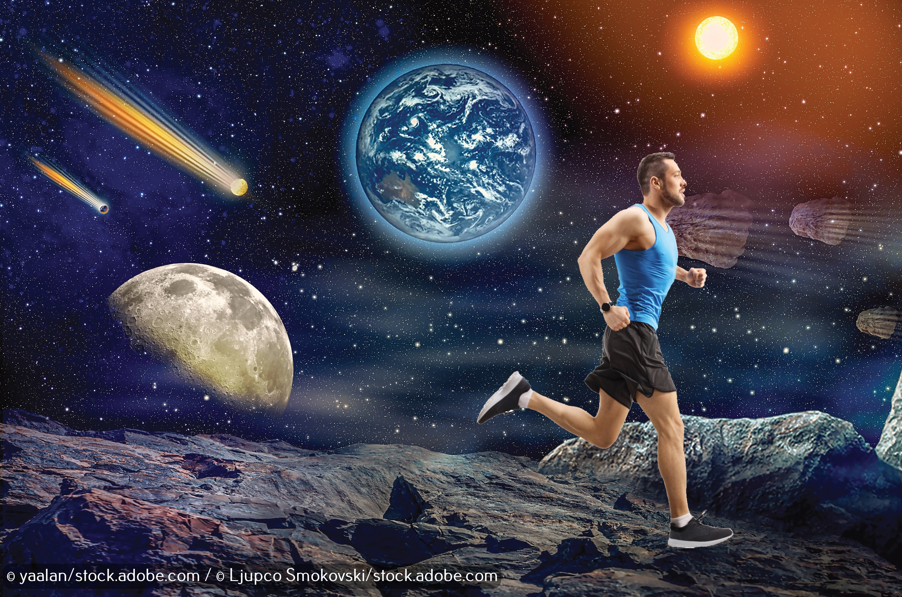

Slide 4
Bitmap graphics
Bitmap graphics, also called raster graphics, store an image as a matrix of dots.
Each dot is called a pixel, short for ‘picture element’.
The colour of every pixel is stored, and every different colour in the picture has its own unique binary code.
It is possible to edit the colour of each individual pixel separately to manipulate an image.

Slide 5
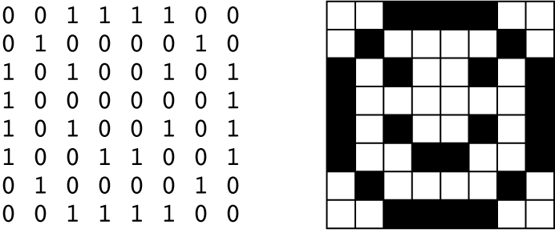
Bitmap graphics
There are two colours in this picture. White is represented by 0 and black is represented by 1.
The image has 64 pixels and the computer stores the colour of each pixel, as well as information about the width and height of the image so that it can be recreated by a computer.

Slide 6
Bitmap graphics and quality
The quality of a bitmap image depends on its resolution. This is the number of pixels in the image.
The higher the resolution, the better quality and more realistic the image. A resolution of 300 dpi (dots per inch) is likely to produce a good quality image.
However, the data for each individual pixel has to be stored, which means that bitmap graphic files are often large.
When a bitmap graphic is enlarged it loses quality and it is sometimes possible to see the individual pixels.

Slide 7
Bitmap graphics and file size
The size of a bitmap graphic file depends on the resolution of the image, and also the size of the image and how many unique colours it contains.
Bigger images contain more pixels and unusual colours have longer numbers, so there is more data to store.
Bitmap graphic files are generally much larger than vector graphic files because of the amount of information the computer needs to store to recreate the image.

Slide 8
Bitmap graphics and file types
Common bitmap graphic formats are:
.tif: Tagged Image File Format (very high quality but large file size)
.bmp: Bitmap Image File (very high quality but large file size; developed for Microsoft® Windows)
.jpg: Joint Photographic Experts Groups (good for email and presentations)
.gif: Graphics Interchange Format (good for web images with up to 256 colours)
.png: Portable Network Graphics (good for web images with up to 16 million colours)

Slide 9
Creating bitmap graphics
It is not practical to draw images by defining each pixel separately. At a resolution of 300 dpi, an A4 image will contain 8,640,000 pixels.
However, it is possible to save any image in a bitmap file format.
For example, digital cameras and smartphones usually save photos in the .jpg format.
These images can then be edited using image editing software.

Slide 10

GIMP (GNU Image Manipulation Program)
GIMP is free and Open Source image editing software.
The ‘Fuzzy Select Tool’ can be used to select and remove areas of the image that have similar colour hues.
The ‘Free Select Tool’ can be used to hand draw around areas of the image, which can then be removed.
Using a transparent background, it is possible to isolate part of an existing image and save it.
Now watch Video 5.1

Slide 11

Activity 5.1: Isolating an image

Slide 12
Quiz 5

